Slide 1
Recursion using Stack by Linkedlist
Supervised By:
Dr. Lamiaa El Refaei - Eng. Shaimaa Yousry

Slide 2


00
Introduction (Data Structure Used)

Slide 3
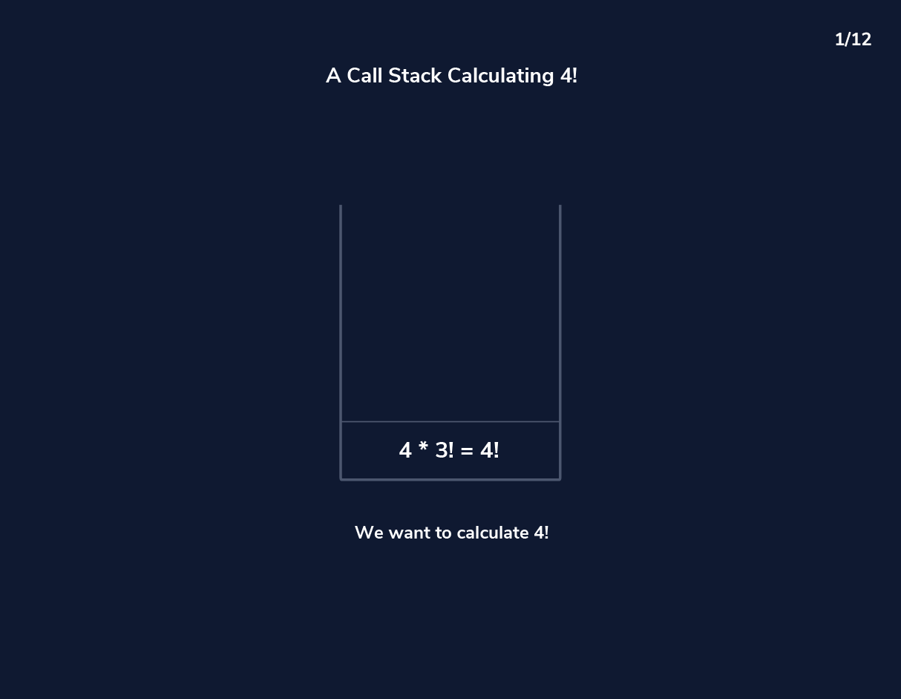

Recursion using Stack
Recursion involves breaking down a problem into smaller, similar sub-problems until reaching a base case.
This process often relies on function calls, which create a call stack to manage local variables and return addresses.
Implementing recursion through a stack based on a linked list offers dynamic memory allocation and flexibility, fundamental aspects of computer organization.

Slide 4

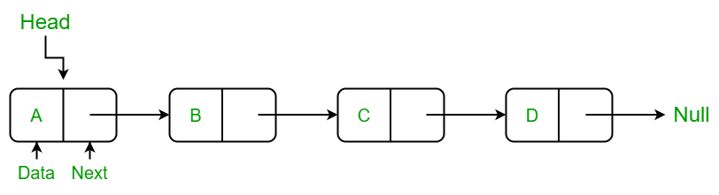
Stack based on Linkedlist
Advantages of using LinkedList instead of Array:
Dynamic Memory Management
Efficient Memory Usage With arrays leads to potential memory wastage. Linked lists only use memory for the actual number of elements in the stack.
Ease of Insertion and Deletion: Linked list has a time complexity of O(1). In contrast, performing the same operations in an array may require shifting elements, resulting in a time complexity of O(n).

Slide 5
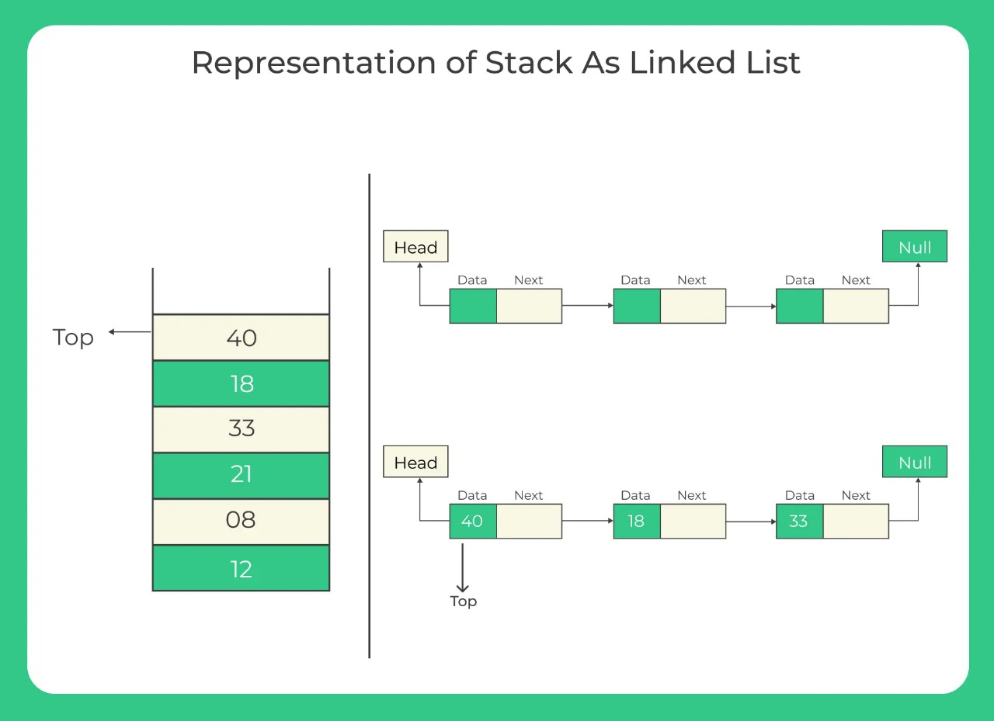
Stack based on Linkedlist
Advantages of using LinkedList instead of Array:
No Maximum Capacity Limitation This means that you can push elements onto the stack until you exhaust the available memory.
Easy Implementation of Other Operations such as peek (viewing the top element without removing it) and isEmpty (checking if the stack is empty).

Slide 6
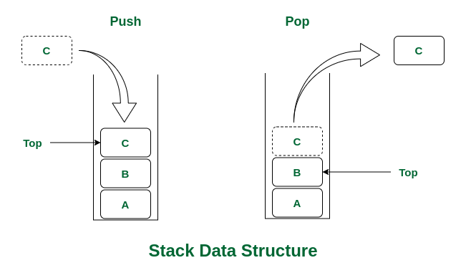

Code Implementation
01
02
03
Push Function
Pop Function
Peek function
04
Main function

Slide 7
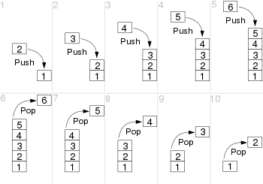

01
Push Function

Slide 8
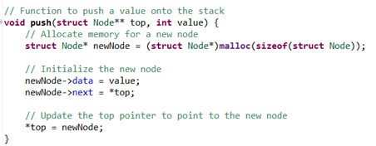
Push Function
C Code:

Slide 9
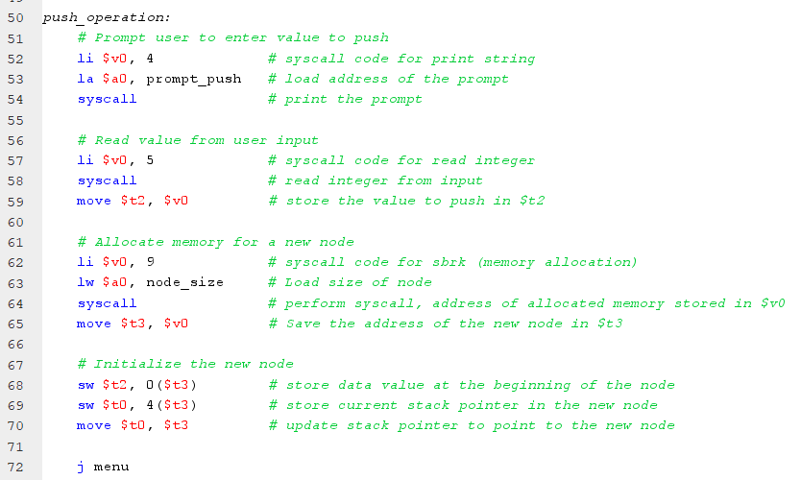
Push Function
Assembly Code:

Slide 10
02
Pop Function

Slide 11
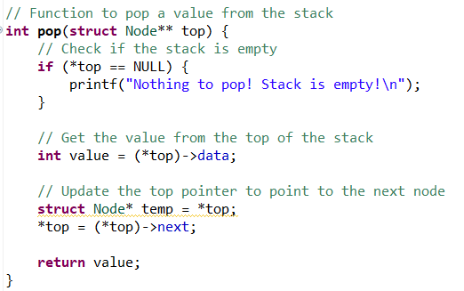
Pop Function
C Code:

Slide 12
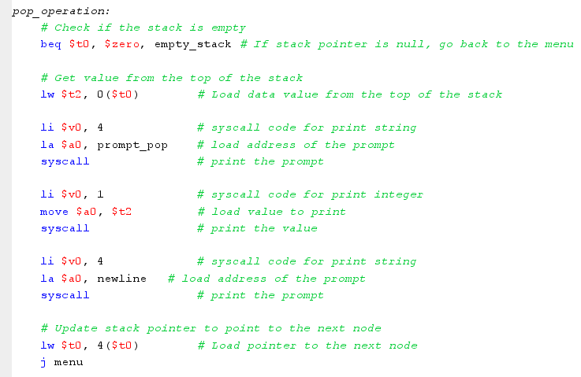
Pop Function
Assembly Code:

Slide 13

03
Peek Funtion

Slide 14
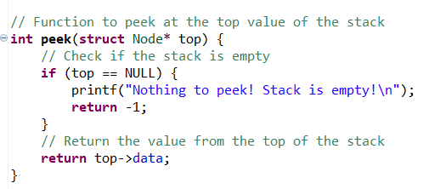
Peek Function
C Code:

Slide 15
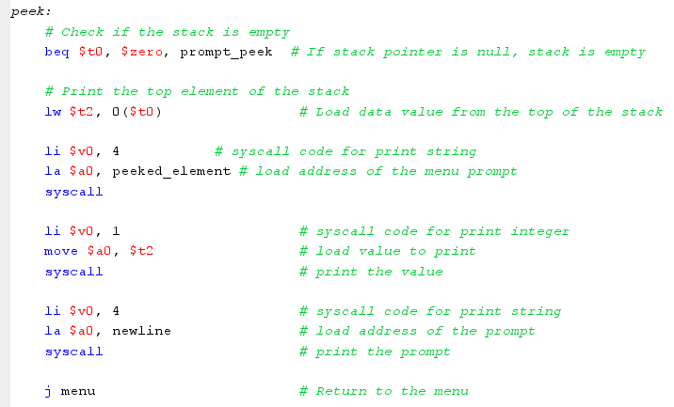
Peek Function
Assembly Code:

Slide 16

04
Main Function

Slide 17
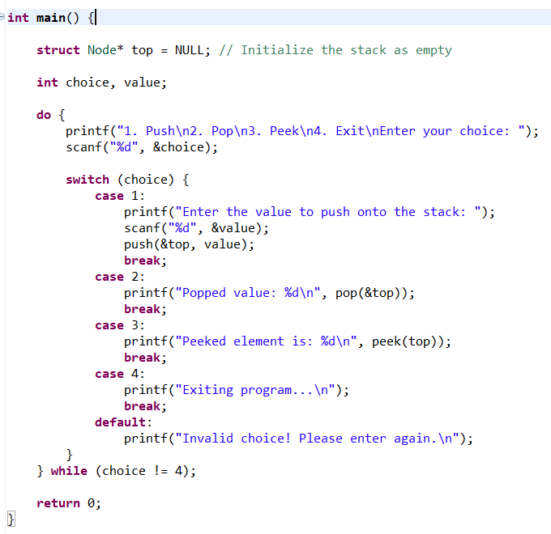
Main Function
C Code:

Slide 18

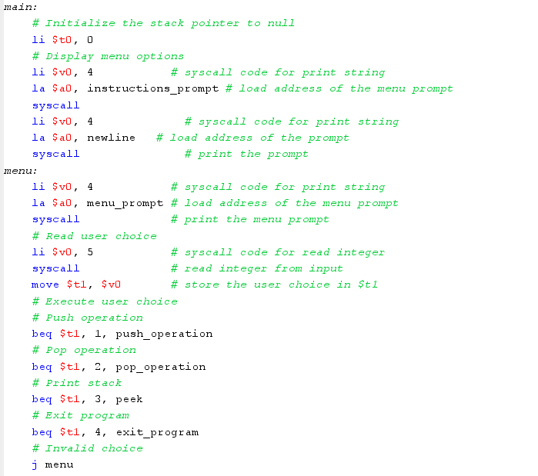
Main Function
Assembly Code:

Slide 19
THANKS!
Presented By:
Nourhan Farag 231903707
Malak Mounir 231903643
Mohannad Mohamed 221903171
Abdelrahman Afify 221903086
Abdullah Mohamed 221903118

